Slide 1
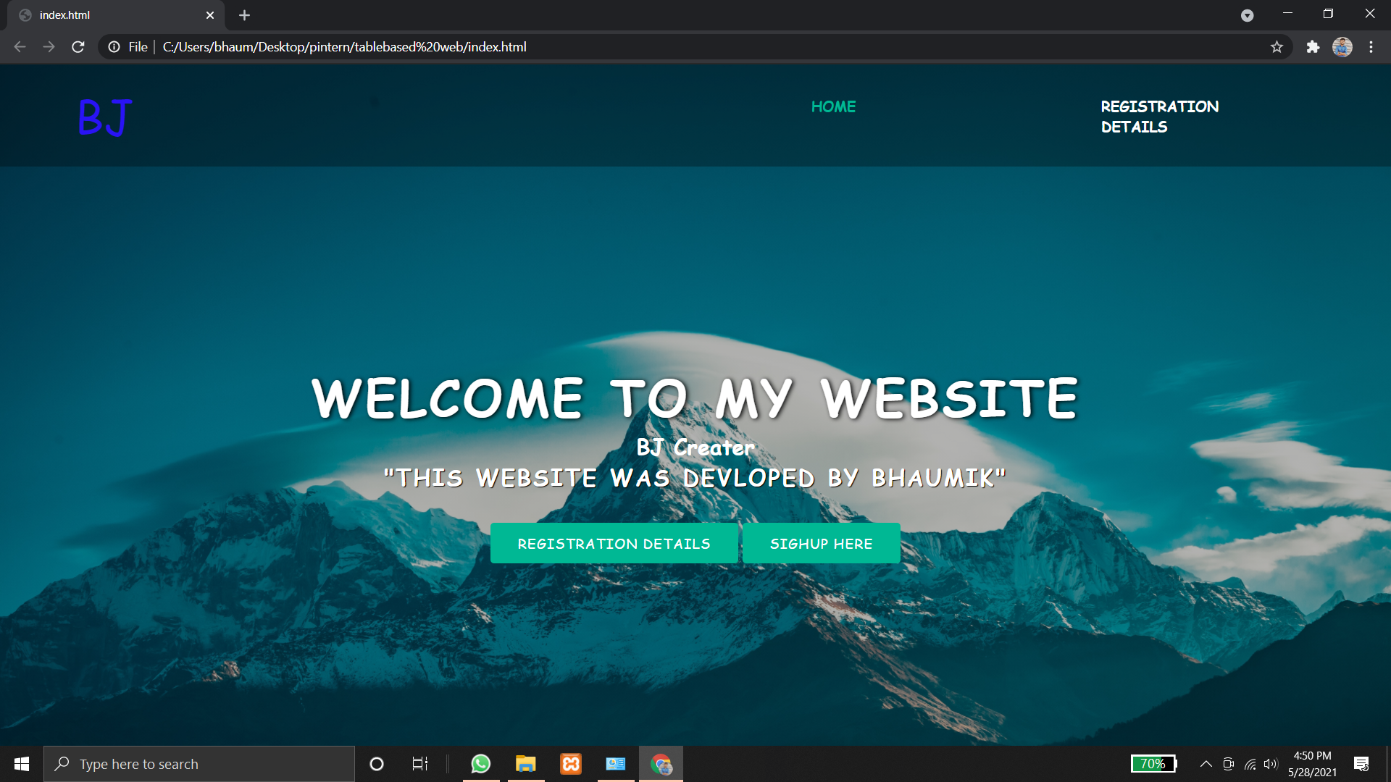
output file

Slide 2
